Slide 1

Session 10 - Environmental Sustainability: Pollution, Climate Change and Resource Depletion
Dr Rajeeb Kumar Sah
08 December 2020

Slide 2
Session Outline
Environmental context of Global Health
Climate change
Pollution – Air pollution
Resource depletion
Environmental Sustainability

Slide 3
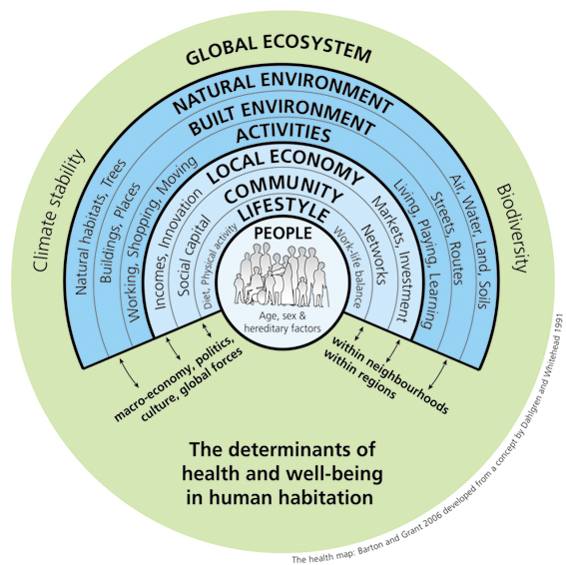
Environmental context of Global Health
Regardless of where we live, human health is affected by the local neighbourhood environment as well as the global environment.

Slide 4
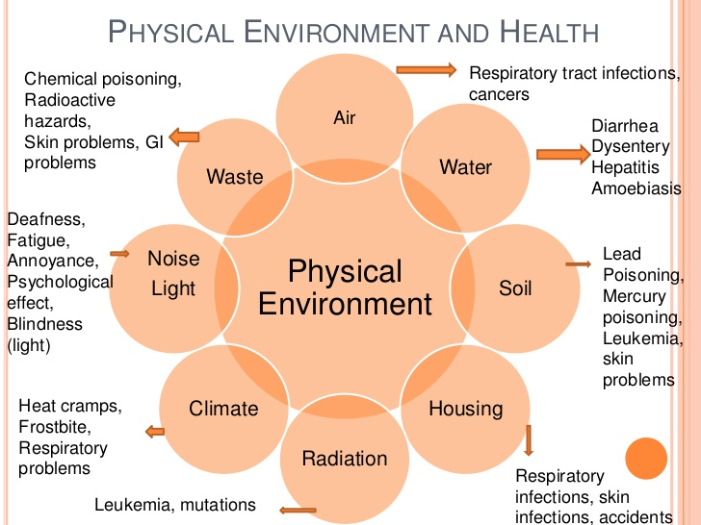

Slide 5
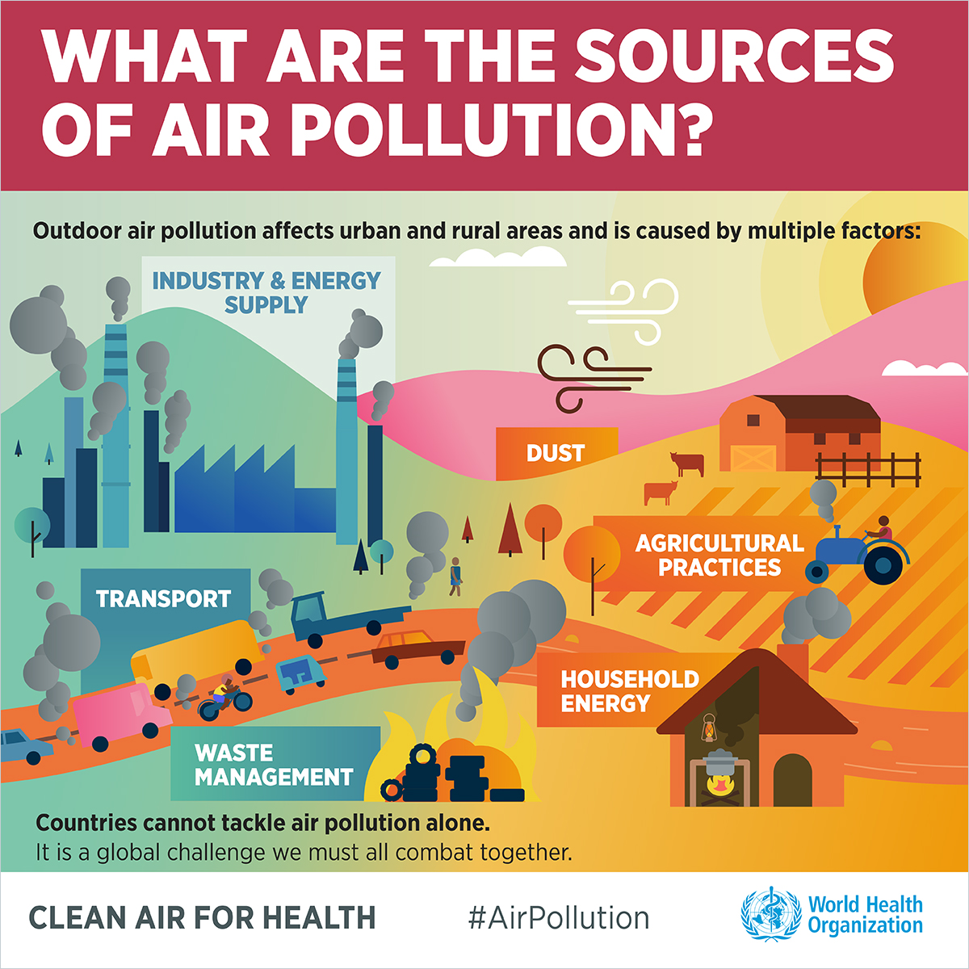
https://www.who.int/airpollution/infographics/en/ (WHO, 2019)

Slide 6
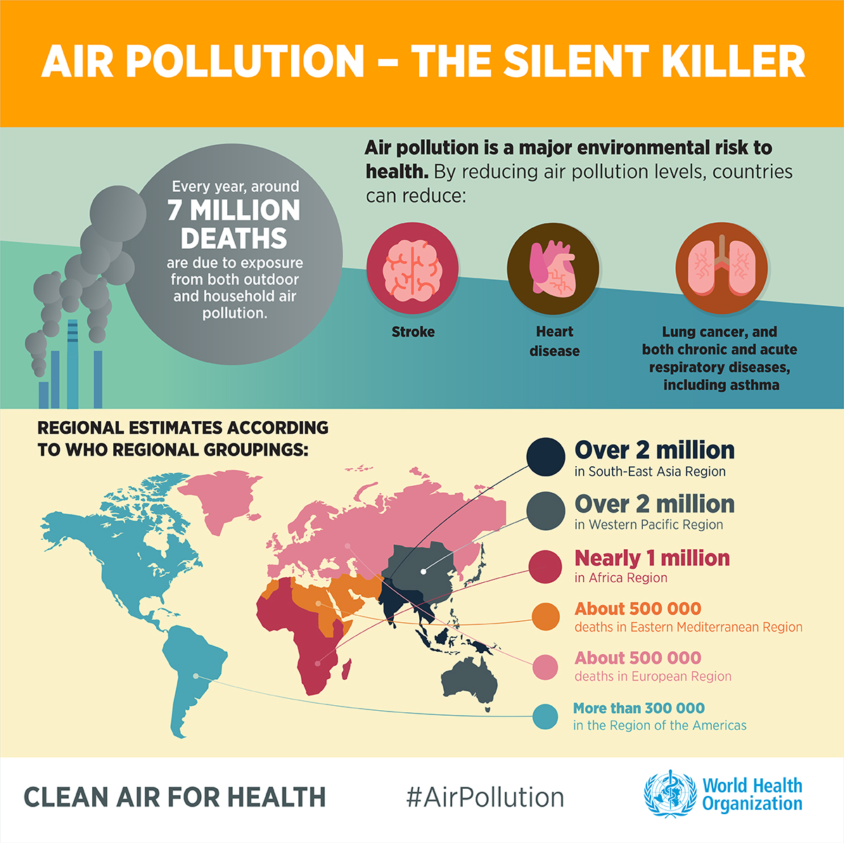
Air Pollution & Energy
Ambient air pollution, also called outdoor air pollution, is the presence of harmful chemicals or other substances in the air at concentrations above the thresholds established for human safety.
Particulate matter (PM) describes substances that are small enough to remain suspended in the air for long periods of time and that can move deep into the lungs.
caused by inefficient energy production, distribution and use, especially in the industrial, transportation and building sectors (both residential and commercial), and by poor waste management.
In high-income countries, air pollution has decreased markedly in recent decades due to efforts to reduce smog-forming emissions and particulate matter.
In LMIC, air pollution has increased largely as a result of population growth and increasing industrialization without adequate control measures.

Slide 7
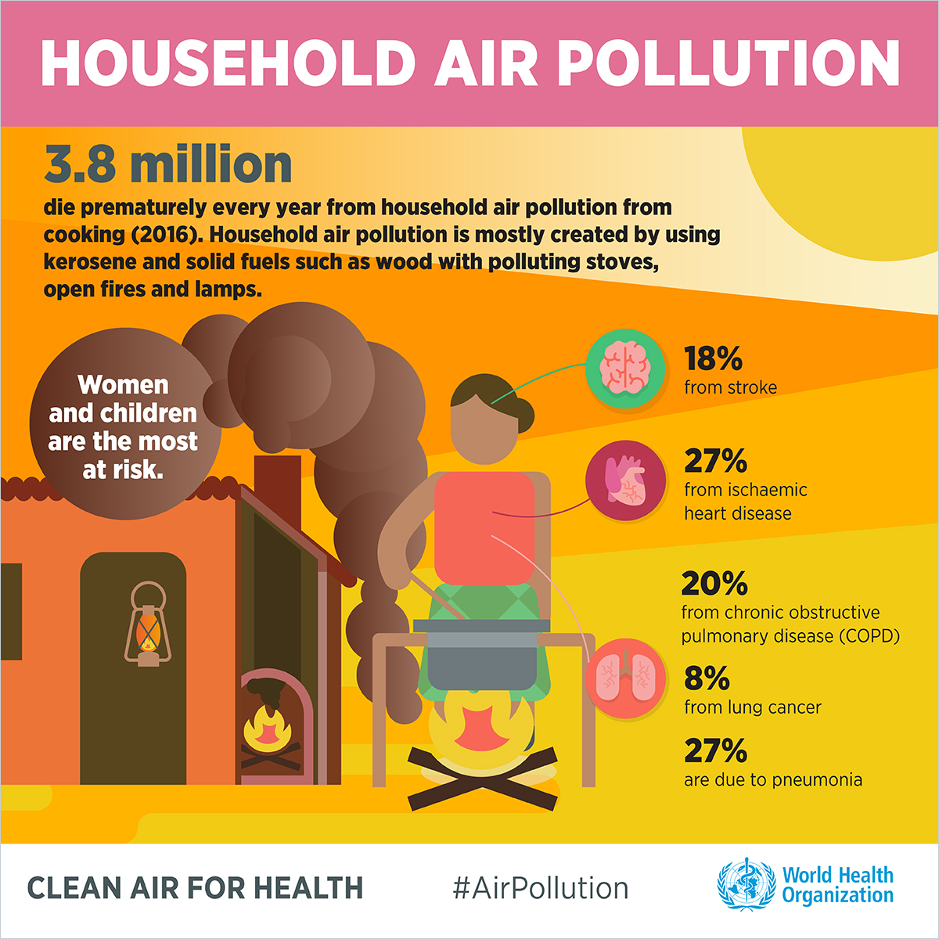
Air Pollution
Household air pollution, also called indoor air pollution, occurs when the air in or near buildings is of poor quality.
Biomass (fuel from organic materials like wood, vegetation, or animal waste - burning of coal, wood and dung) and other solid cooking fuels are particularly unhealthy because they release smoke into the home or cooking shelter.
Most of the 3.8 million premature deaths each year occurs in low- and middle-income countries
risks are particularly high for women and young children who spend several hours a day inside the house near fires while cooking.
can lead to a wide range of adverse health outcomes in both children and adults, from respiratory illnesses to cancer to eye problems.
https://www.youtube.com/watch?v=AcDzsGyYRjI&feature=youtu.be

Slide 8
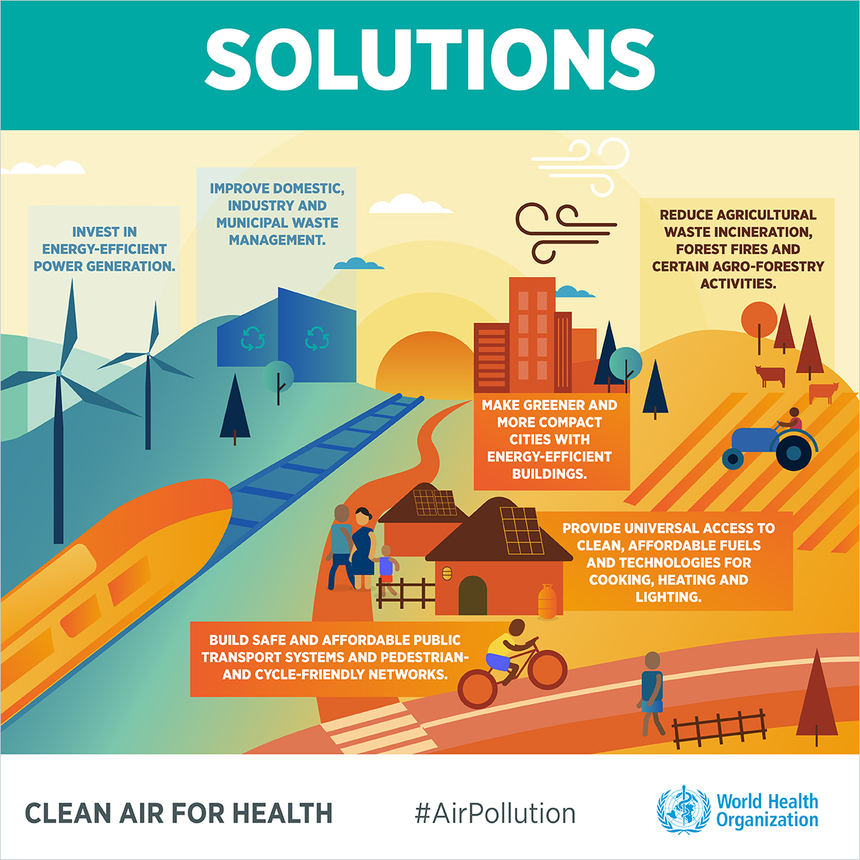
Reducing the Burden of Disease
Household Air Pollution
Improve cooking devices
Use less polluting fuels
Reduce need for fuels by using solar cooking and heating
Use mechanisms for venting smoke
Use dried fuels for cooking
Keep children away from cooking area
Ambient Particulate Matter Pollution
Introduce unleaded gasoline
Use low-smoke lubricant for, or ban, two-stroke engines
Shift to natural gas to fuel public vehicles
Tighten emissions inspections
Reduce burning of garbage

Slide 9
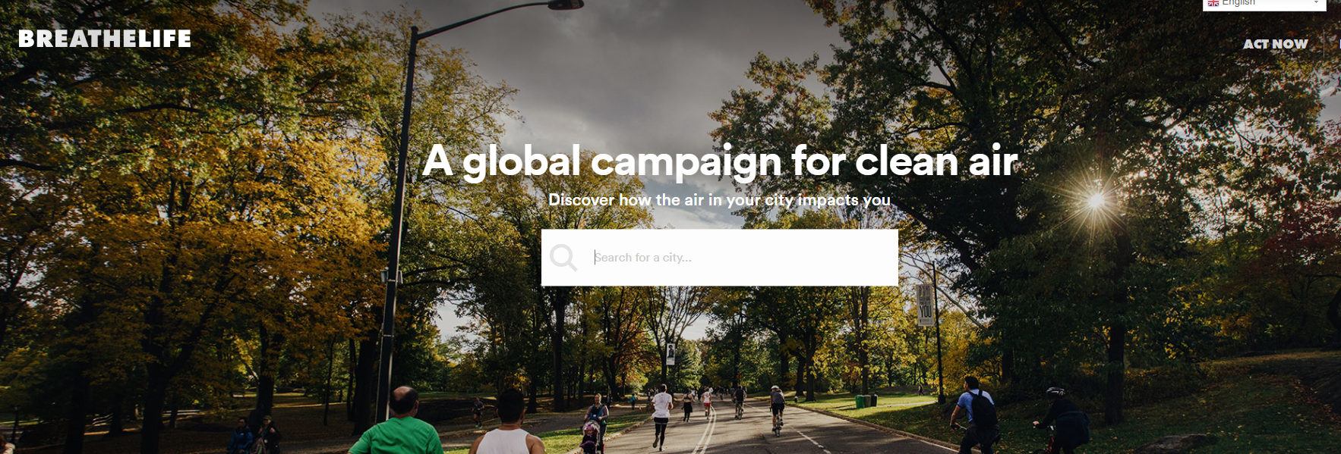
WHO – Breathelife 2030
https://www.youtube.com/watch?time_continue=19&v=8ILIwAAYqAI
http://breathelife2030.org/

Slide 10
Videos on air pollution
https://breathelifedev.wpengine.com/news/breathelife-videos/
https://breathelife2030.org/the-issue/health-and-climate-impacts/
Indoor pollution from cookstoves
https://breathelifedev.wpengine.com/news/breathelife-videos/
Solve different – empower women
https://breathelifedev.wpengine.com/news/breathelife-videos/

Slide 11
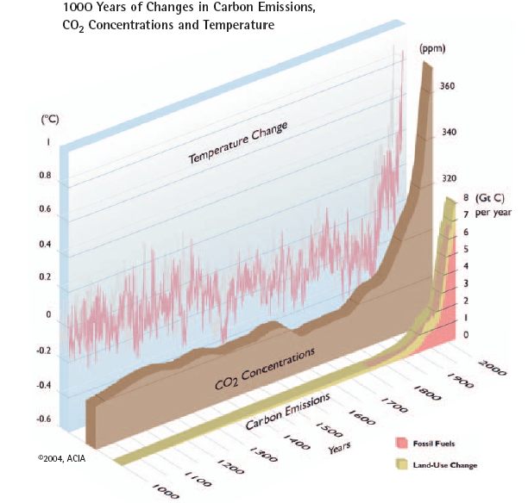
Climate Change
Over the last 50 years, human activities, particularly the burning of fossil fuels, have released sufficient quantities of carbon dioxide and other greenhouse gases to trap additional heat in the lower atmosphere and affect the global climate.
(WHO, 2018)
Climate change is happening
https://www.bbc.co.uk/news/science-environment-24021772
Temperatures are rising rapidly, following increases in CO₂ emissions and concentrations
http://www.who.int/mediacentre/factsheets/fs266/en/index.html
Notes:
The greenhouse effect is fundamental to the climate change debate
Climate change affects the social and environmental determinants of health – clean air, safe drinking water, sufficient food and secure shelter.
Between 2030 and 2050, climate change is expected to cause approximately 250 000 additional deaths per year, from malnutrition, malaria, diarrhoea and heat stress.
The direct damage costs to health (i.e. excluding costs in health-determining sectors such as agriculture and water and sanitation), is estimated to be between US$ 2-4 billion/year by 2030.
Areas with weak health infrastructure – mostly in developing countries – will be the least able to cope without assistance to prepare and respond.
Reducing emissions of greenhouse gases through better transport, food and energy-use choices can result in improved health, particularly through reduced air pollution.

Slide 12
Climate Change
Climate change affects the social and environmental determinants of health – clean air, safe drinking water, sufficient food and secure shelter.
Areas with weak health infrastructure – mostly in developing countries – will be the least able to cope without assistance to prepare and respond.
Between 2030 and 2050, climate change is expected to cause approximately 250 000 additional deaths per year, from malnutrition, malaria, diarrhoea and heat stress.
The direct damage costs to health (i.e. excluding costs in health-determining sectors such as agriculture and water and sanitation), is estimated to be between US$ 2-4 billion/year by 2030.
Reducing emissions of greenhouse gases through better transport, food and energy-use choices can result in improved health, particularly through reduced air pollution.
https://www.who.int/en/news-room/fact-sheets/detail/climate-change-and-health

Slide 13
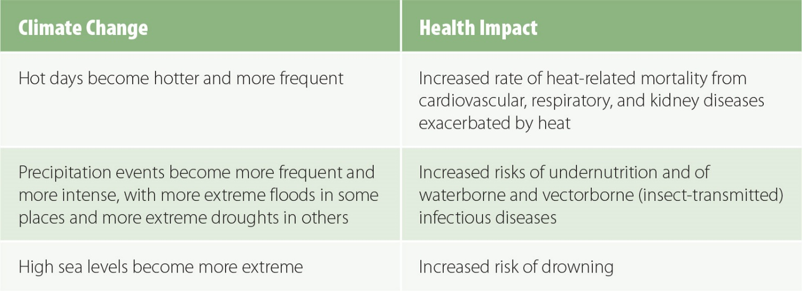
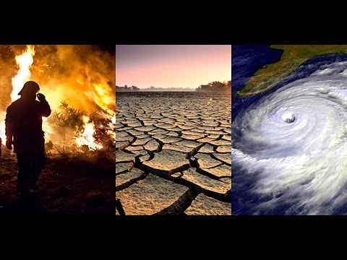
Climate Change
The Intergovernmental Panel on Climate Change (IPCC), a scientific board that reviews and synthesizes scientific data about climate and weather under the auspices of the United Nations, has expressed certainty that global climate changes are occurring and will continue to occur for centuries to come. The IPCC has also concluded that the observed changes are very likely due to human activity.
The United Nations Framework Convention on Climate Change (FCCC) is an international environmental treaty that seeks to reduce greenhouse gas emissions.
The 2015 Paris Agreement is a legally binding set of additional commitments.
Many of the expected climate changes could have significant adverse impacts on human health.

Slide 14
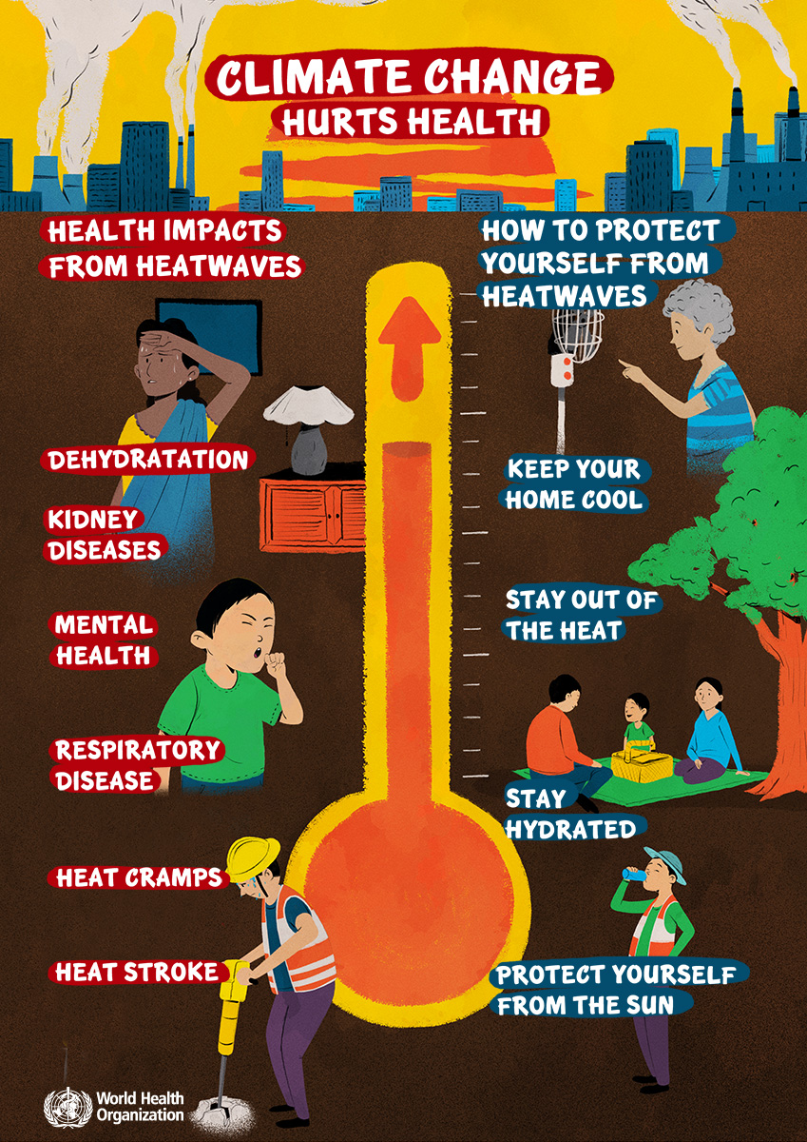
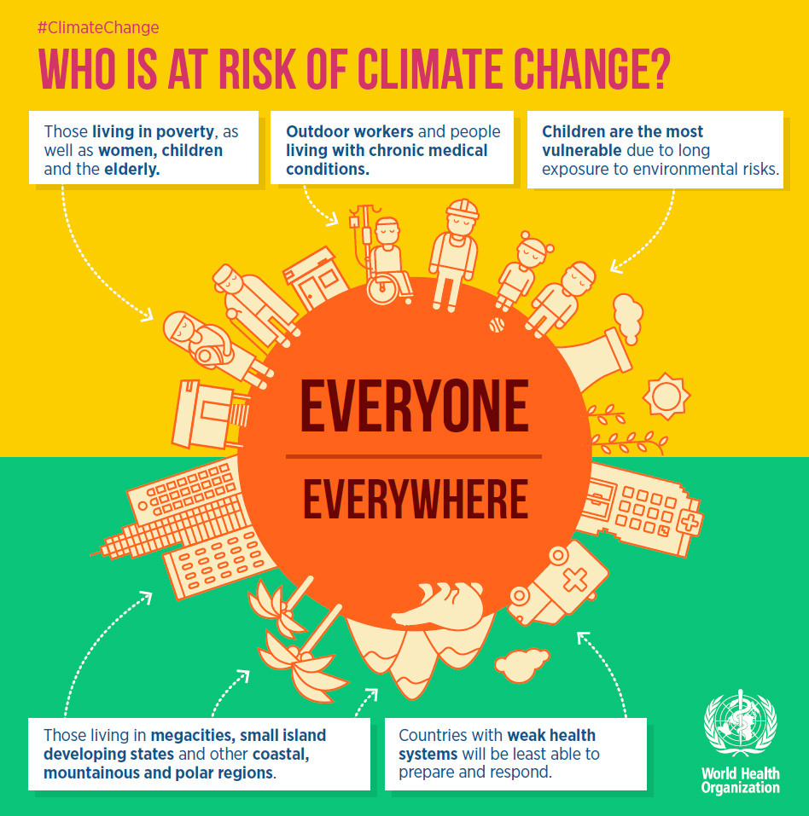
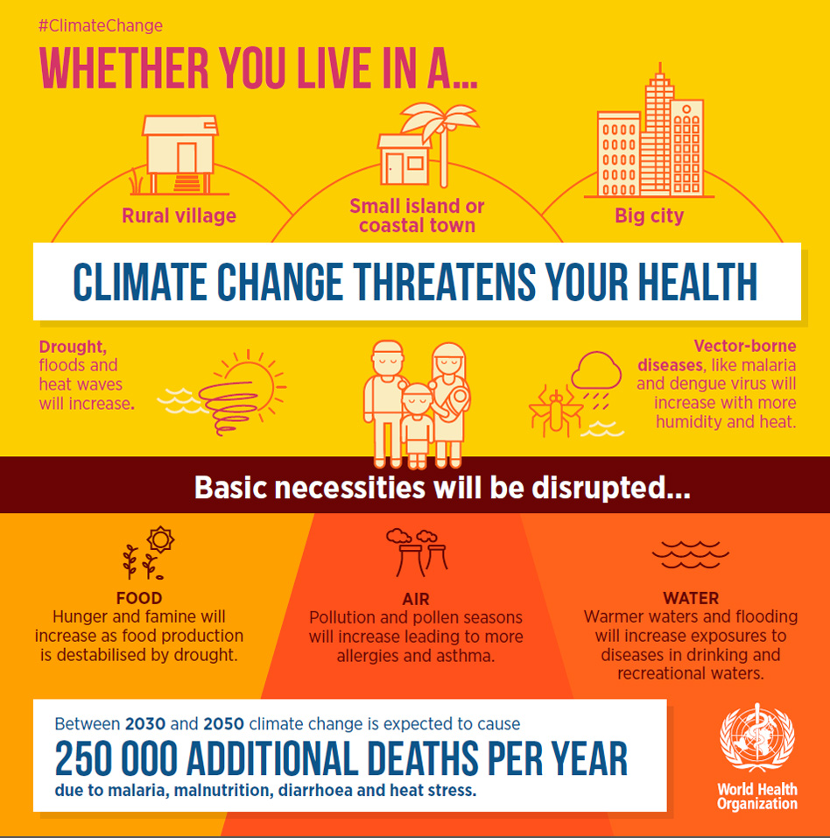
(WHO, 2019)

Slide 15
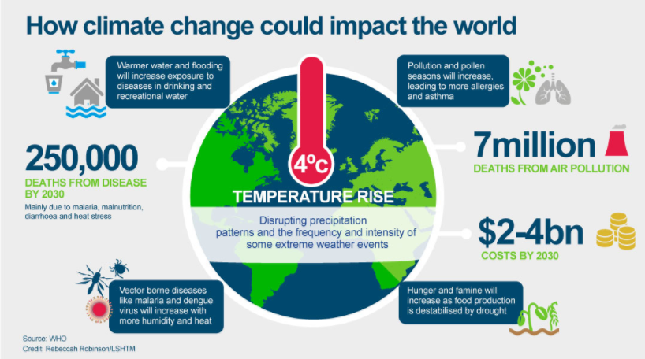
The Costs and Consequences of Key Environmental Health Problems
Social and economic consequences are enormous
Burden falls disproportionately on relatively poor people
Negative consequences on productivity, particularly for women
Young children are especially at risk for consequences of environmental issues
https://www.lshtm.ac.uk/research/research-action/features/how-climate-change-affecting-your-health

Slide 16
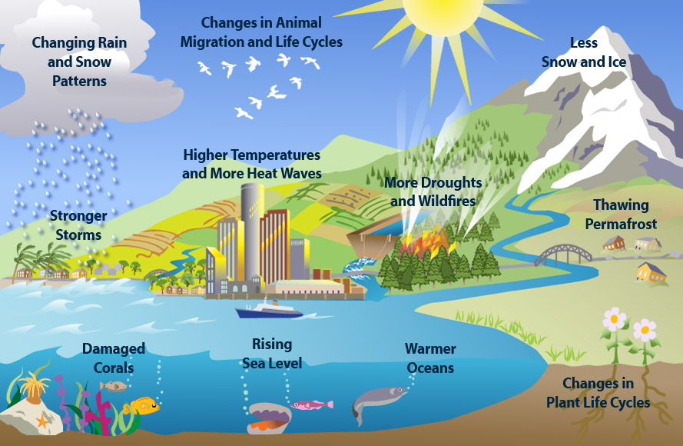
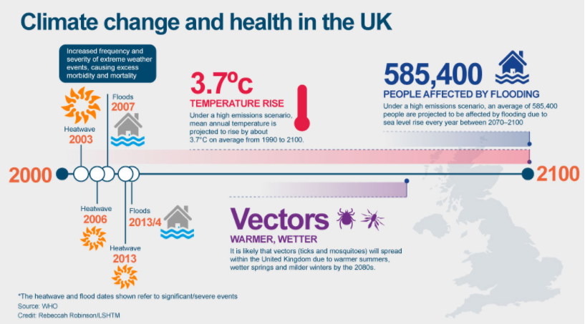
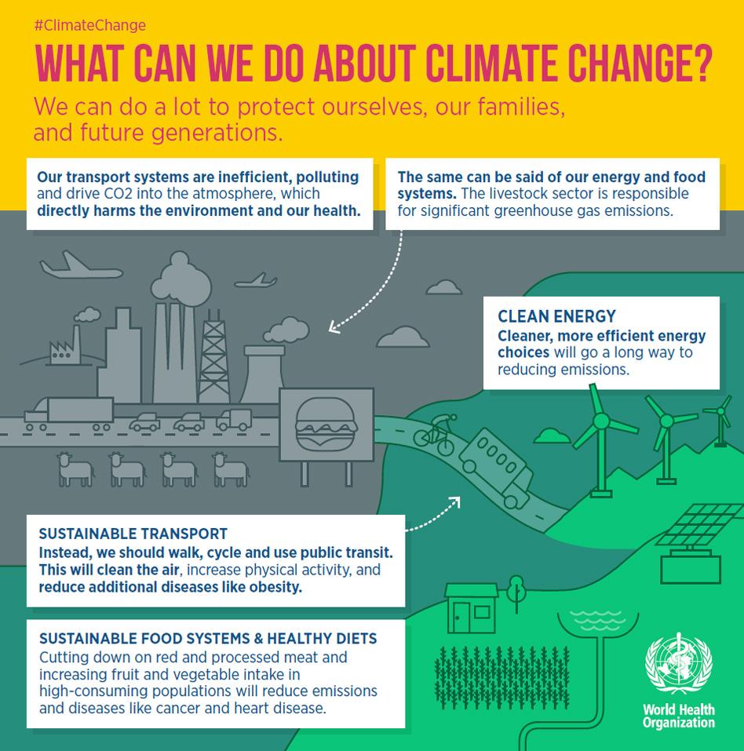
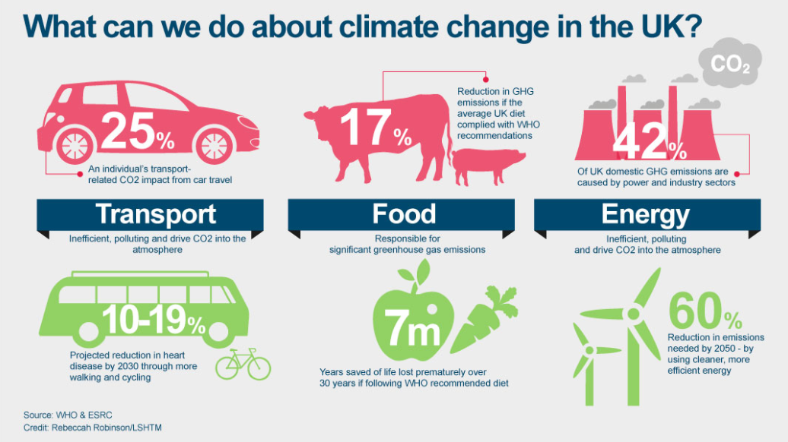
Notes:
The earth’s atmosphere is made up of about 78% Nitrogen and 21% Oxygen. The remaining 1% is made up of trace gases such as argon (<1%), Neon, Krypton, Carbon dioxide (0.04%), methane (0.0018%), water vapour, ozone etc.
Solar radiation from the sun powers the earths climate

Slide 17
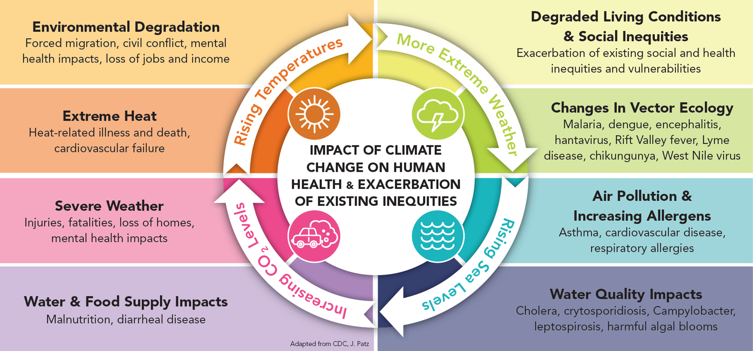
Without effective responses, climate change will compromise:
Water quality and quantity: Contributing to a doubling of people living in water-stressed basins by 2050.
Food security: In some African countries, yields from rain-fed agriculture may halve by 2020.
Control of infectious disease: Increasing population at risk of malaria in Africa by 170 million by 2030, and at risk of dengue by 2 billion by 2080s.
Protection from disasters: Increasing exposure to coastal flooding by a factor of 10, and land area in extreme drought by a factor of 10-30.
Notes:
References for all figures given in WHO, 2009. Protecting Health From Climate Change: Connecting Science, Policy and People, World Health Organization, Geneva; page 7. http://www.who.int/globalchange/publications/reports/9789241598880/en/index.html

Slide 18
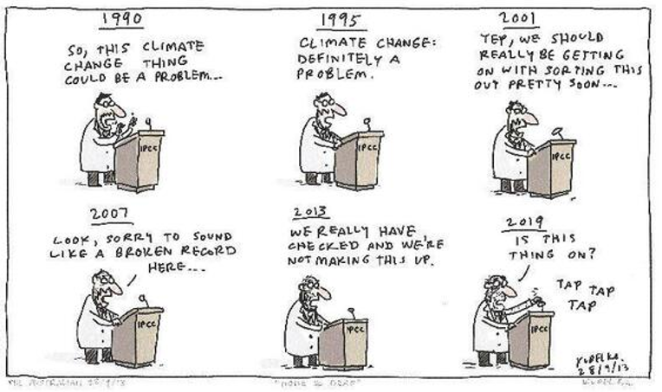
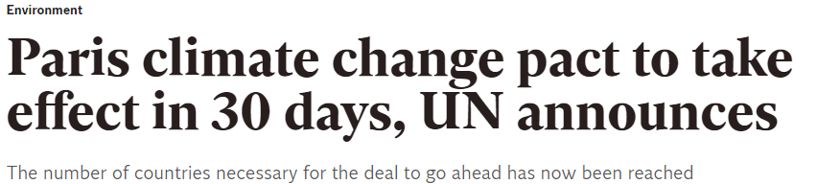
http://www.independent.co.uk/environment/paris-climate-change-pact-effect-30-days-un-announcement-eu-canada-nepal-a7347091.html

Slide 19
Resource Depletion
Resource depletion, environmental degradation and climate change pose fundamental threats to human security. Separately or in combination with other factors, they can destabilize livelihoods, negatively affecting ecosystems, and undermine peace and development. Where local and national institutions lack the capacity to resolve disputes that may arise over the degradation or depletion of resources, violent conflict can emerge. As population and economic growth increase, so does the demand for scarce resources and the potential for conflict.
http://www.un.org/en/land-natural-resources-conflict/pdfs/GN_ExeS_Renewable%20Resources%20and%20Conflict.pdf

Slide 20
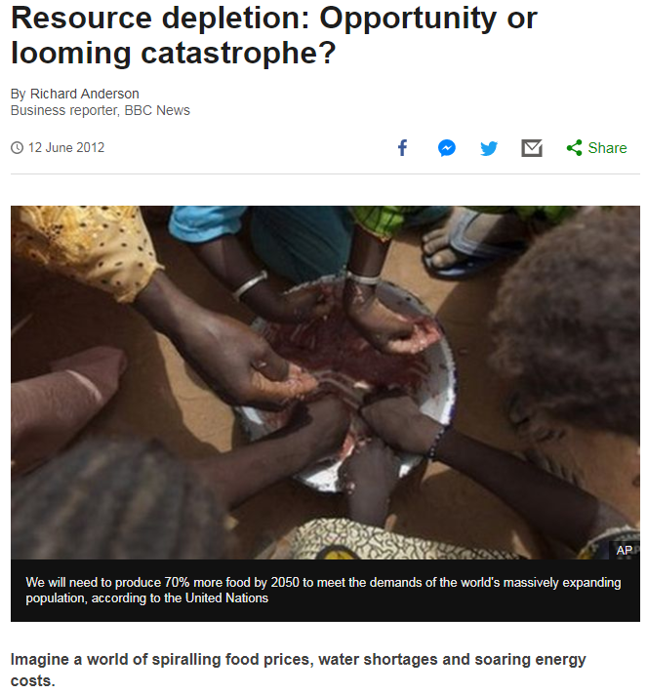
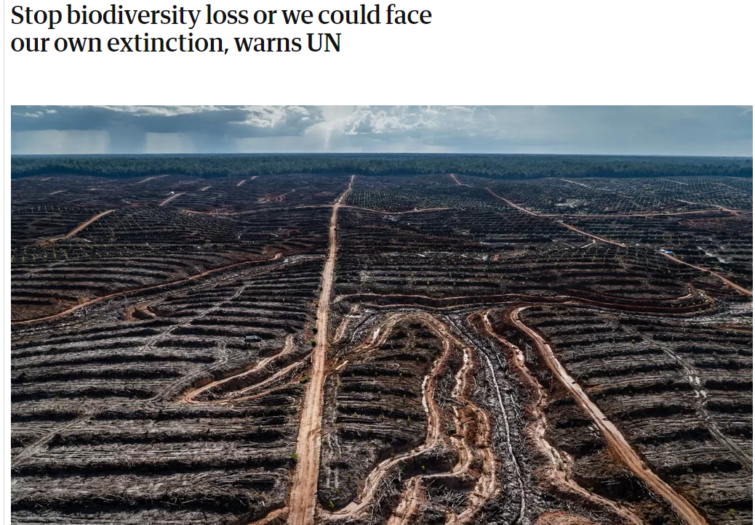
Resource Depletion
https://www.bbc.co.uk/iplayer/episode/m000pjw4/the-burning-scar

Slide 21
Resource Depletion
Resource depletion is of concern to both present and future generations in terms of access to resources. Sustainable development implies that meeting the needs of the present should not compromise the ability of future generations to meet their own needs. One important aspect of sustainable development is the conservation of natural resources for societal needs. This is particularly important in the case of fossil fuel resources, since once consumed, they cannot be re-used or recycled and therefore accelerated extraction will hasten their depletion, leading to scarcity.
Rimos, S., Hoadley, A. F., & Brennan, D. J. (2014). Environmental consequence analysis for resource depletion. Process Safety and Environmental Protection, 92(6), 849-861.

Slide 22
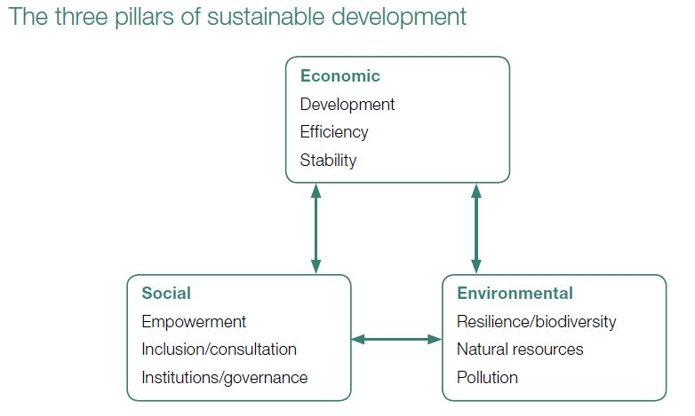
Three Pillars of Sustainability:
Business or country uses its resources efficiently and responsibly so that it can operate in a sustainable manner.
Ability of society or any social system to persistently achieve a good social well being.
we are living within the means of our natural resources.
(NAO, 2010)

Slide 23
What is sustainability about?
Becoming educated and involve citizens of this changing world and determining what needs to be done and what role we play in our individual corner of the world.
Taking action with wartime speed because time is running out, restoring what is broken and finding fresh approaches that are truly regenerative
Emergence of a new dynamic state of the world in which there is a room for everyone in which every living being can pursue its right to live and to thrive
Balancing the great systems and cycles of the planet, from microscopic to local to global, that will endure over long periods of time
(Robertson, 2014)

Slide 24
Environmental sustainability is a core pillar of the post-2015 development agenda
Much work remains for the post-2015 period, particularly given the acute environmental challenges the world is facing, such as climate change, food and water insecurity, and natural disasters.
Environmental sustainability is a core pillar of the post-2015 agenda and a prerequisite for lasting socioeconomic development and poverty eradication.
Poor people’s livelihoods are more directly tied to natural resources, and as they often live in the most vulnerable areas, they suffer the most from environmental degradation.
Healthy, well-managed and diverse ecosystems and resources can play a strong role in mitigating future environmental challenges and improving livelihoods everywhere.
Therefore, it is crucial to ensure that the development agenda for the future reflects the links between socioeconomic and environmental sustainability and protects and reinforces the environmental pillar.

Slide 25
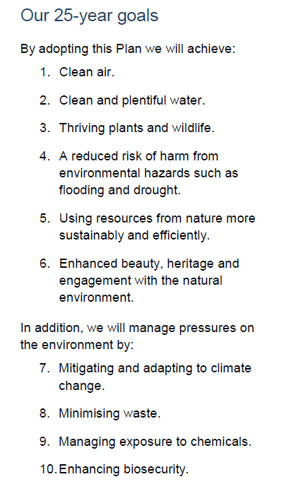

UK Government initiatives
(HM Government, 2018)

Slide 26
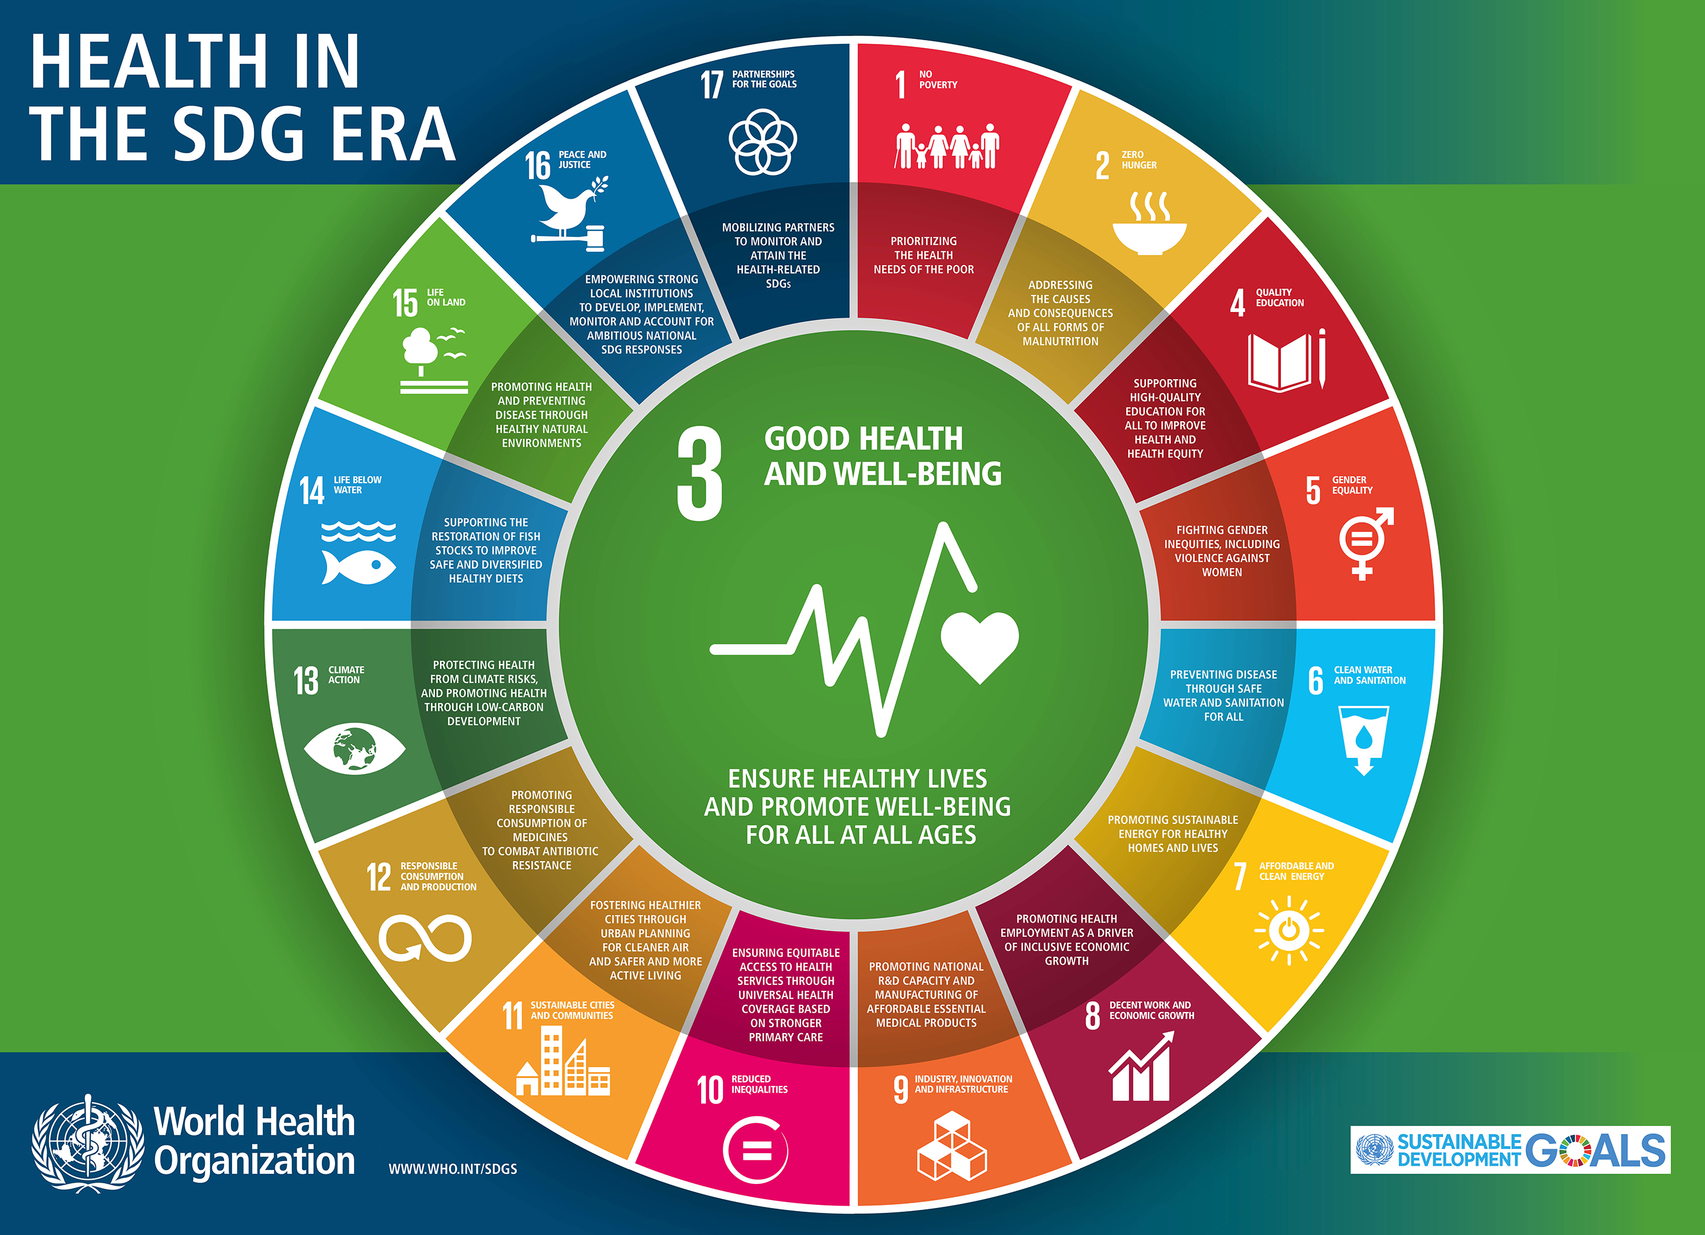
Which of these SDGs are relevant in the Pollution, Climate Change and Resource Depletion and Why?
http://www.un.org/sustainabledevelopment/

Slide 27
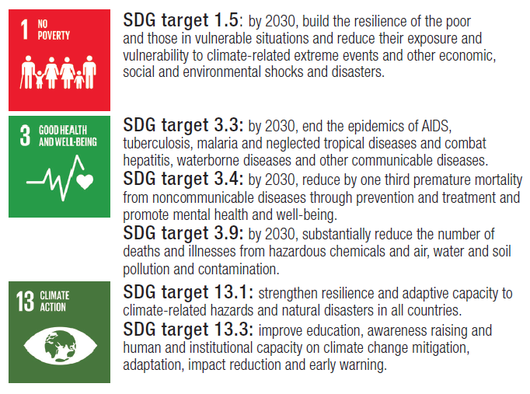
Climate Change and SDGs
http://www.euro.who.int/__data/assets/pdf_file/0007/347983/13-Fact-sheet-SDG-Climate-change-FINAL-25-10-2017.pdf?ua=1

Slide 28

Next Session:
MDGs and SDGs
Assignment Discussions
Essential Readings
Jacobsen, K. H. (2019) Introduction to global health. Burlington, MA: Jones & Bartlett. Chapter 2
2.4 Millennium Development Goals
2.5 Sustainable Development Goals

